Slide 1


Westgate Water Main Replacement Project
Project Staff – City of Ann Arbor
Francisca Chan
Project Manager
fchan@a2gov.org
734.794.6410 ext. 43701
Luke Liu
Transportation Engineer
yliu@a2gov.org
734.794.6410 ext. 43637
Jasmine Isaac
Community Engagement Specialist
Jisaac@a2gov.org
734.794.6320 ext. 425
Notes:
Michelle

Slide 2

Project Purpose and Overview
Replace the 1960’s watermain in Westgate Shopping Center to improve water pressure and reliability.
Replace over 1,600 ft watermain and associated valves. Reconnect water service connections to the new watermain.
Restore parking lot areas after construction is completed.

Slide 3
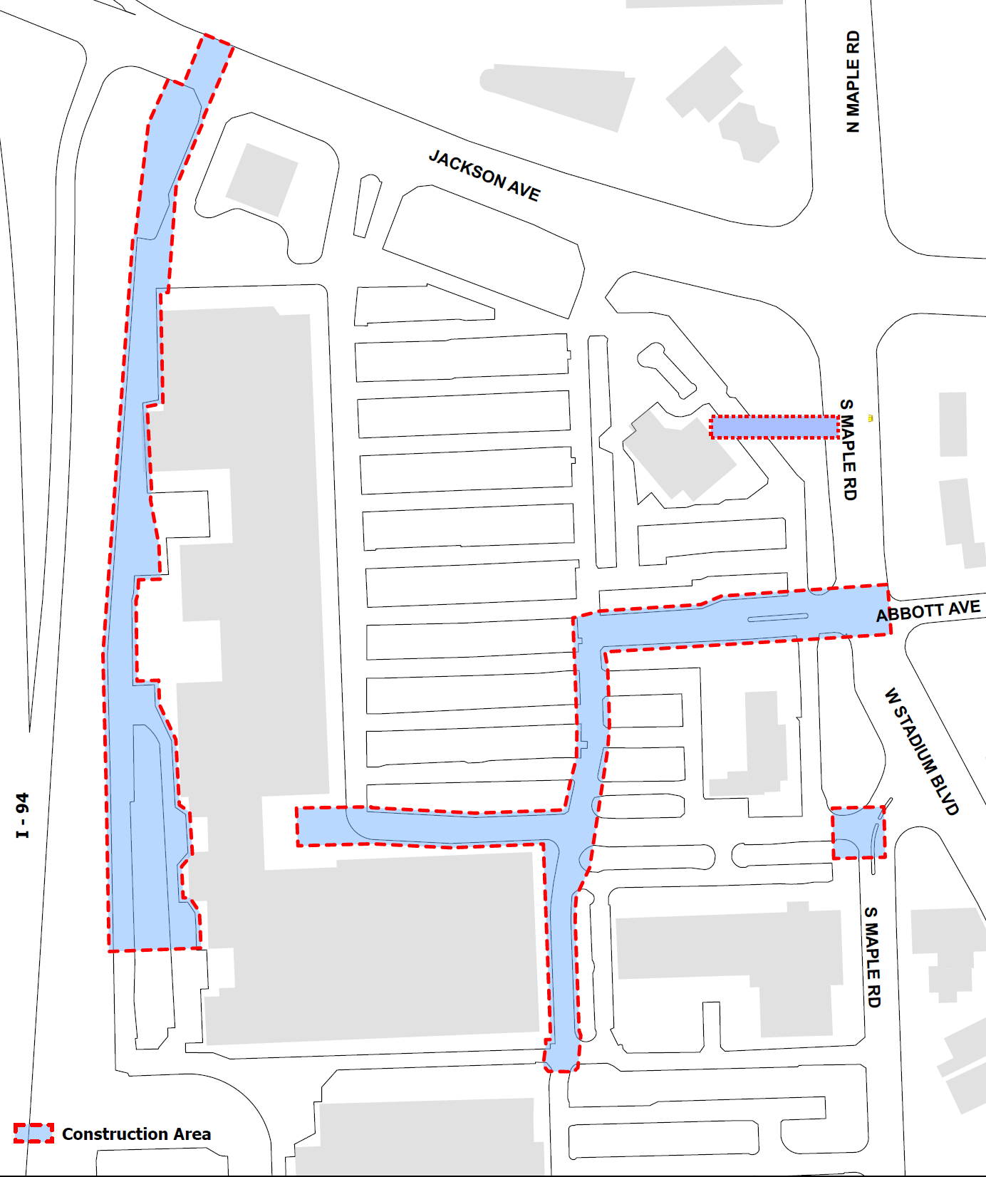


Project Boundaries:
Westgate Shopping Center
West Phase
East Phase
North Tie In at Maple
South Tie In at Maple
Additional construction staging areas
Notes:
Tracy – two projects were combined and will be installed at the same time\
Originally this was just 7th and greenview s of scio church, but with the timing of everything we added the rest of greenview to stadium to be done all at the same time.

Slide 4
Construction Impacts
Tentative Start Date: May 7th 2025; End date: Late August 2025
Temporary parking restrictions
Dust and noise during working hours
Some temporary water service interruptions with notice provided, one short 30 min and one long approximate 8 hours.

Slide 5
Construction Impacts
Access and services will be maintained:
Local access for residents/business owners
Driveways – some exceptions
Emergency vehicles
Mail/deliveries
Cart and dumpster collections

Slide 6

Follow-up Expectations
For additional questions and concerns, please fill out the contact survey on the website.
LINK: https://engage.a2gov.org/westgatewaterproject

